Slide 1
Spring Colloquium 2011 Final Project By Jennifer Sager

Slide 2
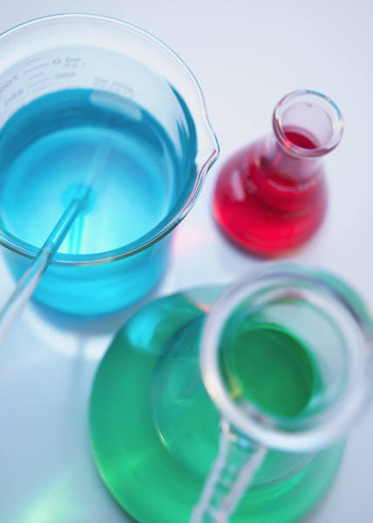
Home Improvements…
Lights /Fans
Outlets
Hairspray
Reduce, Reuse, Recycle!!

Slide 3
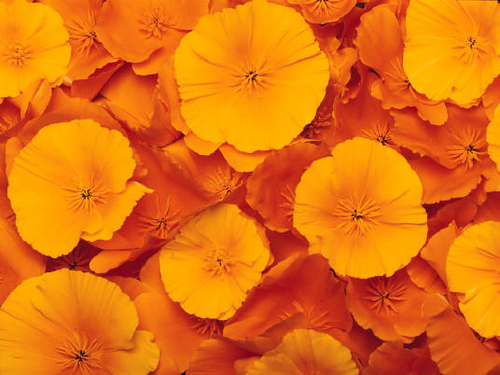
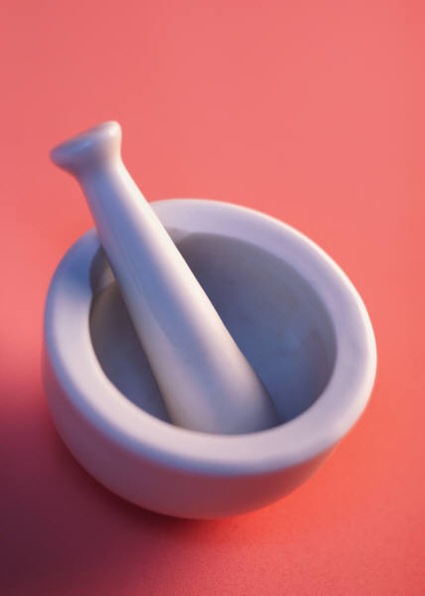
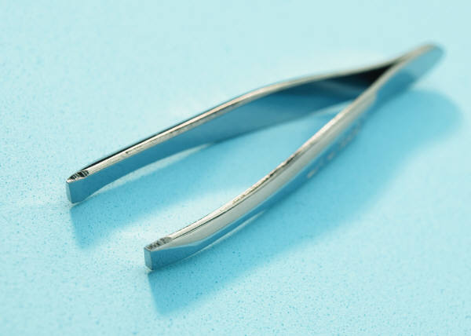
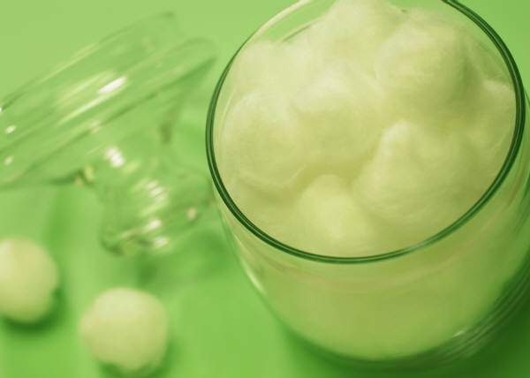
Gulf Coast Hospital Improvements
Proper disposal and recycling of Kardexs
Reduction of disposal cup use

